Slide 1


An adaptive stock index trading
decision support system
Wen-Chyuan Chiang, David Enke, Tong Wu, Renzhong Wang
BIGDATA LAB 정다운
2017년 04월 05일(수)

Slide 2
Contents
Information
Concepts
Introduction
Background
System overview
System architecture
Independent variables
Experimental results
Conclusion

Slide 3
Information
Title
An adaptive stock index trading decision support system
Authors
Wen-Chyuan Chiang, David Enke, Tong Wu, Renzhong Wang
Journal
Expert Systems with Applications
Volume, Pages
Volume 59, Pages 195-207
Year Published
15 October 2016

Slide 4
Concepts
Predicting the direction and movement of stock index prices is difficult, often leading to excessive trading, transaction costs, and missed opportunities.
Often traders need a systematic method to not only spot trading opportunities, but to also provide a consistent approach, thereby minimizing trading errors and costs.

Slide 5
Concepts
While mechanical trading systems exist, they are usually designed for a specific stock, stock index, or other financial asset, and are often highly dependent on preselected inputs and model parameters that are expected to continue providing trading information well after the initial training or back-tested model development period.

Slide 6
Introduction
Computer technology is becoming increasingly involved in the area of finance.
As previously studied stock prices do not completely move in a random walk, but are nonlinearly related to historical data, as well as various other fundamental, technical, and macroeconomic factors.
In studying these nonlinear relationships, nonlinear regression and neural networks have often been utilized for prediction and clustering.

Slide 7
Introduction
Systems that use technical analysis, along with expert systems and other forms of computational intelligence for chart pattern recognition, have also been developed.
Nonetheless, such systems are often sensitive to the selection of input variables and parameter settings, and typically do not offer the ability to adapt once trained or modeled for a specific stock, stock index, or other financial asset.

Slide 8
Introduction
Decision support systems (DSS) have been recognized as a useful tool for helping users plan and make decisions.
Before the popularity of neural networks, most research focused on time series analysis, which is used to extract meaningful statistics and forecast future events based on historical data.
Previous research illustrated that neural networks can be an effective tool for stock market prediction

Slide 9
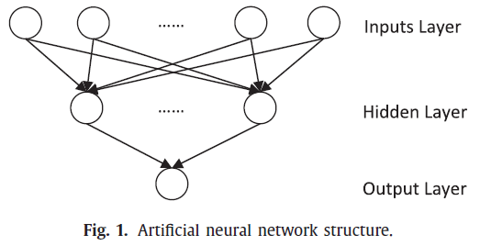
Background(Artificial neural network)

Slide 10
Background(Artificial neural network)
ANN(Artificial Neural Networks)
An artificial neural network is composed of many artificial neurons that are linked together according to a specific network architecture. The objective of the neural network is to transform the inputs into meaningful outputs.
Output
Inputs

Slide 11
Background(Artificial neural network)
ANNs have become an important tool in statistical data modeling, especially for discovering the non-linear relationship between an input and output dataset.
An ANN consists of groups of neurons that are interconnected.
The architecture usually includes one input layer, one or more hidden layers, and an output layer.
The ANN updates its interconnection weights toward optimization by processing the inflow of data and the computation of an output.

Slide 12
Background(Particle swarm optimization)
Particle swarm optimization (PSO) is a computation method that optimizes a problem by improving a candidate solution iteratively based on a fitness measurement function.
PSO can be used together with artificial neural networks for initializing the weights and training the network.
In the former case, PSO is used to pre-train a neural network to arrive at an optimum initial set of network weights.

Slide 13
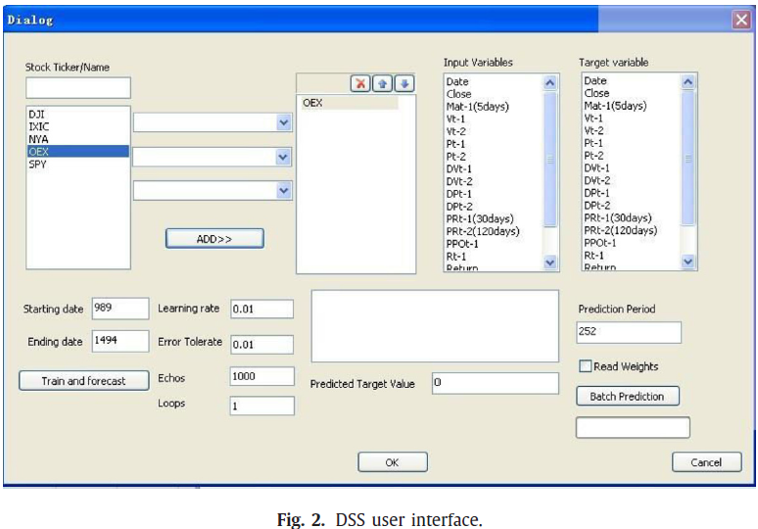
System overview

Slide 14
System overview
An adaptive stock direction prediction system has been developed in this paper.
The system utilizes an artificial neural network to forecast the movement of future stock prices.
Direction information is then used as trading signal in order to assist users in making trading decisions.
The output from the neural network will be standardized between zero and one.

Slide 15
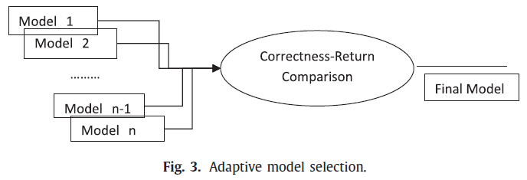
Forecasting methodology(adaptive methodology)

Slide 16
Forecasting methodology(adaptive methodology)
The accuracy of the prediction and network performance are greatly impacted by the selection of the inputs for the neural network.
Initially, a general model was developed to describe the relationship among stock index variables.
Principal component analysis, genetic algorithms, and decision trees are widely used for filtering representative variables.

Slide 17
Forecasting methodology(adaptive methodology)
Therefore, in the proposed system, the final prediction model will vary for each individual stock index.
Inputs will be selected from a group of potential variables provided by experts.
Some network parameters may also vary in different cases, such as the learning rate, maximum epochs, or the learning time frame.
The software determines the selection of variables as shown.

Slide 18
Forecasting methodology(adaptive methodology)
With N potential variables, the different possible combination of inputs for the neural network will reach 2 N -1, which can be a huge number with increasing N.
Based on a number of experiments we conducted in our research, we find that most of the best performing models have five variables or less.
As a result, we set the maximum number of the inputs for the neural network at five, such that the number of combination for inputs can be reduce to the following, where N is the number of potential variables.

Slide 19
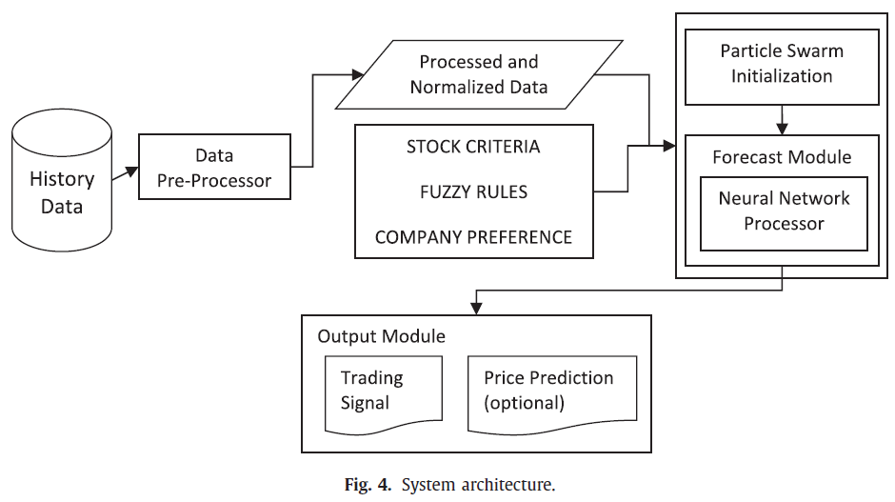
System architecture

Slide 20

System architecture(Data preprocessor)
The first module in the system architecture is the data preprocessor, which normalizes the input data between the range of 0 and 1.
where V i is the raw data, while V min and V max are the minimum value and maximum value among the data, respectively. V n represents the value after normalization.

Slide 21
System architecture(Particle swarm in neural network initialization module)
In order to improve the efficiency, the particle swarm algorithm has been adopted in this module.
The particle swarm algorithm has a larger searching space, which will help the neural network avoid the local optimal.
The output of the particle swarm optimization will be used as the initial weights for the neural network.

Slide 22
System architecture(Neural network training module)
The neural network training module consists of a 3-layer feedforward network with one hidden layer.
In the proposed system, the number of nodes in the hidden layer is set equal to 2N–1, where N is the number of inputs.
The number of nodes in the output layer is 1, the stock movement direction.
As mentioned earlier, the backpropagation algorithm has been adopted as the learning algorithm.
This module is designed to conduct a training process and prediction.

Slide 23
System architecture(Output module)
The trading signal will be presented in the output module.
There are three different scenarios: buy, hold, and sell.
If traders are not holding any stock indexes when the direction prediction is greater than 0.5 (buy signal), they will buy the stock index, otherwise, the trader will do nothing.
If the trader is holding the stock index when the direction prediction is greater than 0.5, they will hold the stock index, otherwise, when the direction prediction is less than 0.5 (sell signal), the stock index will be sold.

Slide 24
Independent variables
Analysis starts from the selection of potential variables, which will be used in the model as inputs.
Economic variables are usually released monthly and quarterly and typically stay the same for a specific period.
As a result, economic variables are excluded from our daily forecast.
For daily prediction, the most important parameters are the closing price and volume of the stock index for the last trading day.

Slide 25
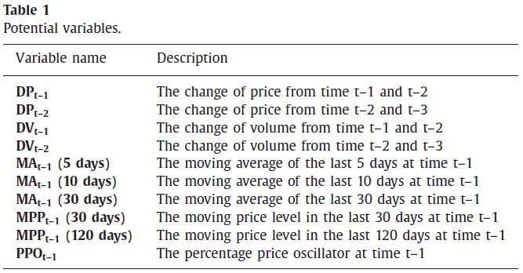
Independent variables

Slide 26
Independent variables(MA)
Moving averages are a frequently used measurement in technical analysis, indicating short and long-term direction trends based on the period in which the average is calculated.
The moving average of the previous five trading days’ closing price is considered in the proposed system, providing a short-term trend analysis.
This shorter period is better suited for daily trading. For the analysis, a simple Moving Average (MA), which is the non-weighted mean of the previous n data points, is calculated as
where P t−n is the stock price at time t − n .

Slide 27
Independent variables(MPP)
For this research, a Moving Price level Percentage (MPP) measure is used as an indicator for support and resistance.
To obtain the MPP for the last K days, we initially calculate the increment between the current price and the minimum price for the last K days.
Dividing the increment by the difference of the maximum and minimum stock index price over the K trading days gives the MPP.
A larger MPP suggests a higher level of price, and potential bigger level of resistance (smaller value otherwise).

Slide 28
Independent variables(PPO)
The Percentage Price Oscillator (PPO) is a technical momentum indicator showing the relationship between the short-term and long-term averages.
In a traditional view, a buy signal is issued when PPO measures above 0, while a sell signal is issued when PPO is below 0.

Slide 29
Independent variables(PPO)
where EMA stands for the Exponential Moving Average.
Closing prices and volumes were collected from finance. yahoo.com.
The time series used was from January 29, 2004 to June 24, 2011. The various price and volume changes, as well as the chosen technical indicators, were calculated in Excel based on the collected data.
In total, 12 variables are selected to form a potential parameter pool as shown in Table 1 .

Slide 30
Experimental results
The proposed system trained the neural network with two years of daily data from January 2008 through December 2009.
A twelve-month sample from January 2010 through December 2010 was retained to access the prediction performance of the neural network.
In order to evaluate the performance of the neural network for generating trading signals, a Direction Correctness Percentage (DCP) was calculated.
The DCP measures what percentage of the direction predictions are inline with the real direction changes in the historical data.
If the DCP is greater than 50%, it may be possible to profit from the system.

Slide 31
Experimental results
To illustrate how the proposed system adaptively develops the final model, the simulation results from testing the SPY (S&P 500 Index ETF) and IXIC (NASDAQ Composite Index) are used as examples.
For each scenario, direction predictions were conducted over the 252 trading days in year 2010 (typically 365 days minus weekends and holidays).
In those simulations, trading was conducted in accordance with the signals suggested by the proposed system.
An accumulative return over the one-year period was then calculated.

Slide 32
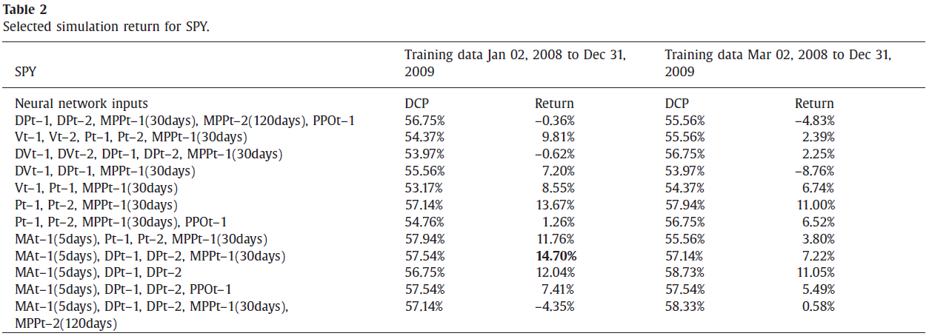
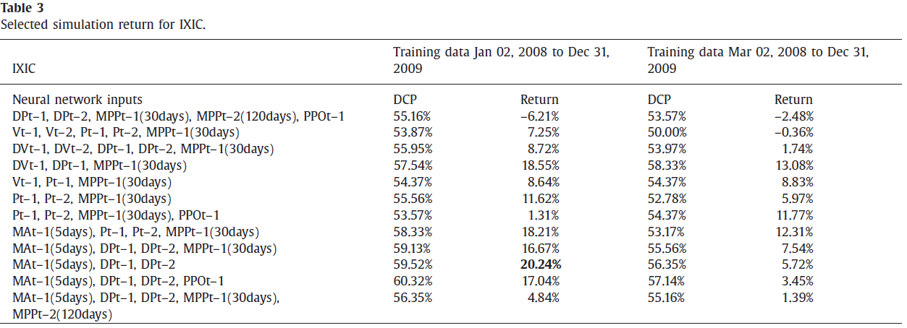
Experimental results

Slide 33
Experimental results
It can be clearly observed that the combination of parameters significantly affects the performance of prediction.
Such results illustrate that a single model may not fit every stock index.
Another interesting observation is that higher prediction accuracy does not always guarantee higher return, further highlighting why return is used as the criteria for determining the final predictive model.

Slide 34
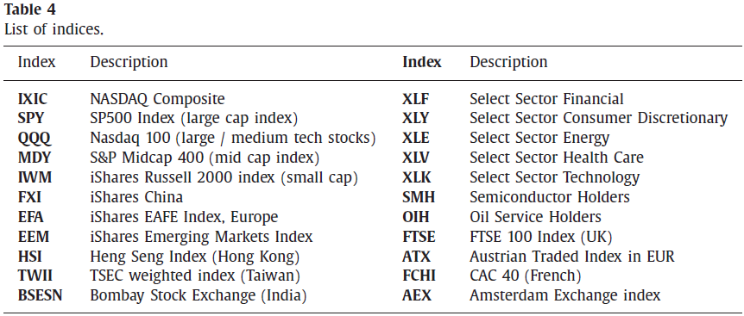
Experimental results

Slide 35
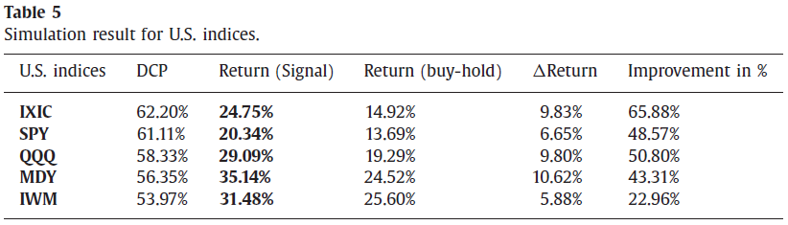
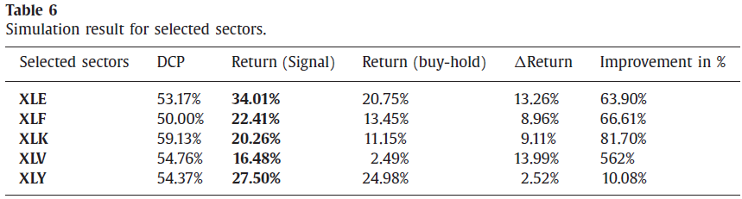
Experimental results

Slide 36
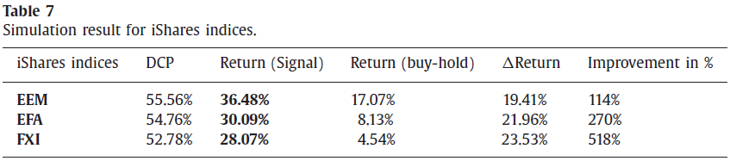
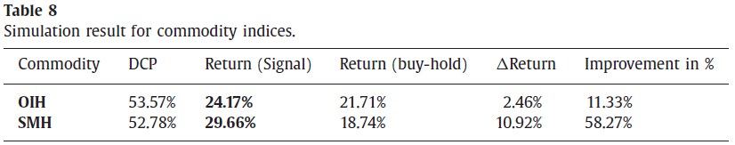
Experimental results

Slide 37
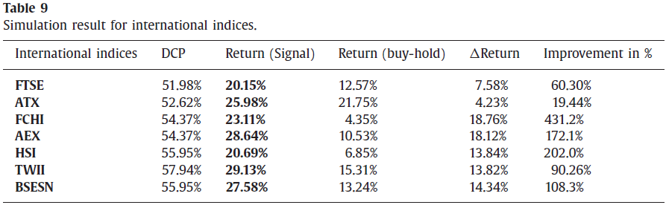
Experimental results

Slide 38
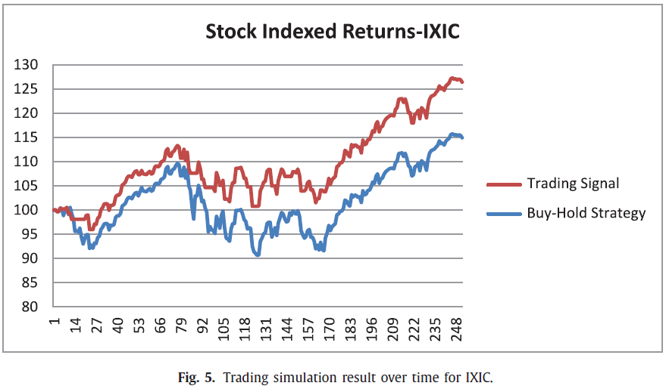
Experimental results

Slide 39
Experimental results
Investigation of the simulation results reveals that the system sometimes fails to recognize small price changes, but predicts the major changes in price movement.
It can be observed that the system helped avoid several sharp downturns during the simulation, which occurred at the 12th, 78th, 89th, 122nd, 150th, and 160th days.
Nonetheless, for this simulation there were still 50 transactions that occurred during the 252 trading days, including 25 buy and 25 sell signals.
This suggest that even without small movement trades, excessive trading transition cost may still eliminate the benefits of the trading system in those cases where the additional return generated by the model was not significant.

Slide 40
Experimental results
This is due in part to various noises in the stock market, such as those caused by speculation and program trading, among others.
In addition, selling stocks at every downturn will result in numerous transactions, generating higher transaction fees.
As a result of the noise in the stock market, there exist meaningless movements during a short-term period.
Therefore, as an additional test, the data was smooth using a wavelet transformation before providing it to the neural network.
Wavelets are considered a very useful tool for extracting information from various types of data.

Slide 41
Experimental results
where s(n) = noisy signal, f(n) = principal content, σ = volatility, and e(n) = the noise.
The denoising process is designed to filter out the noise and recover signal f .
Signal f is considered as useful data with less noise. Fig. 6 illustrates the transformation of the original data into de-noised data for the SPY ETF.
From Fig. 6 , one can observe that the de-noised price and volume movement are smoothed.
The trends of these data are thus clearer.
The system can be improved by ignoring small fluctuations but remain effective in detecting larger trends.

Slide 42
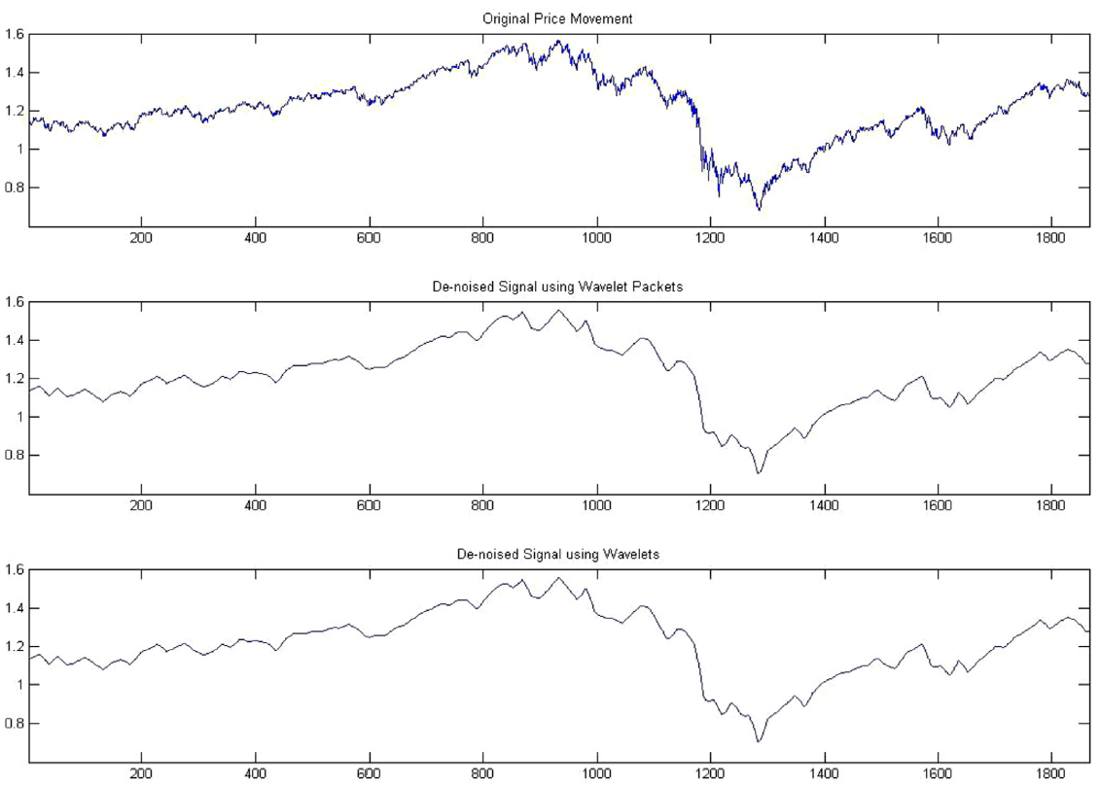
Experimental results

Slide 43
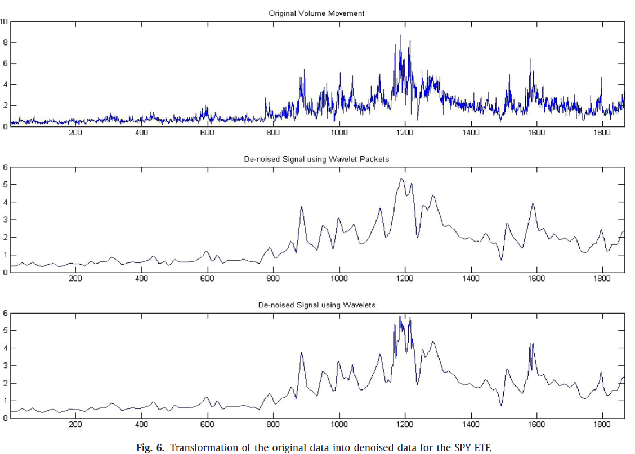
Experimental results

Slide 44
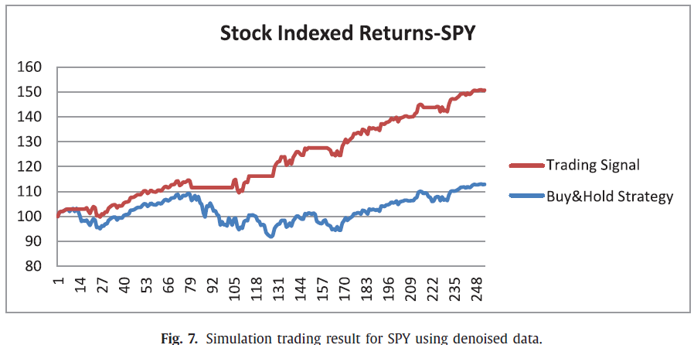
Experimental results

Slide 45
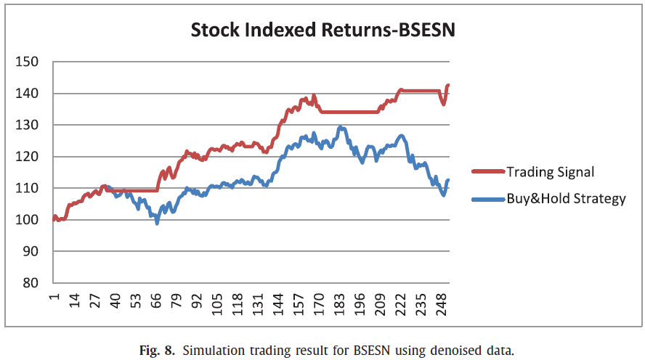
Experimental results

Slide 46
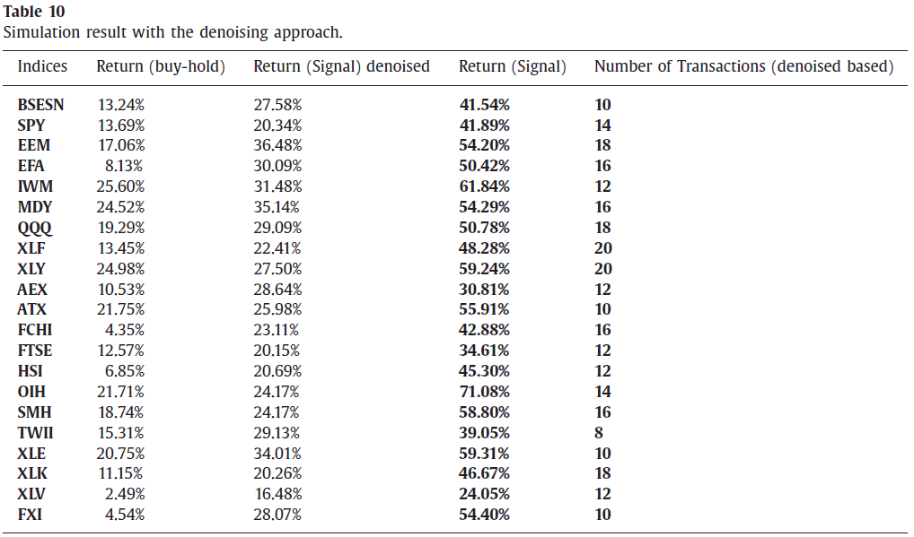
Experimental results

Slide 47
Experimental results
The number of transactions was on average14 (including both buying and selling), down from an average of 50 without denoising.
As can be seen from Table 10 , the denoising approach helped the trading system in two aspects.
First, the returns are greatly improved.
Second, the number of transactions is dramatically lower, and hence the transaction costs are reduced.
Often, when prices are noisy, there is an increase in the number of false signals.
The use of denoising has the benefit of not only reducing the amount of unprofitable trades, but it does so by helping to better isolate the underlying trend, even in periods with noisy price action.
This can have a positive impact in the areas of financial risk management and general trend forecasting.

Slide 48
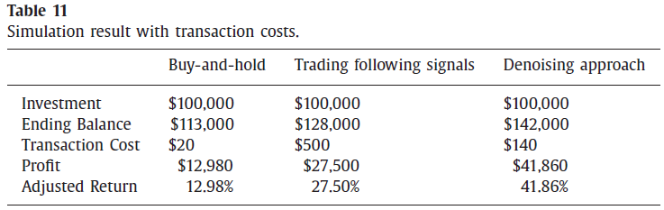
Experimental results

Slide 49
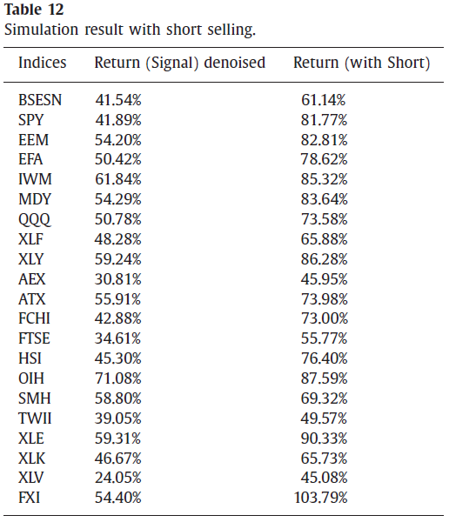
Experimental results

Slide 50
Conclusions
The proposed adaptive model is unique in that it optimizes network performance for each individual stock index, and only uses those technical indictors that facilitate the best network performance.
Different from other research approaches regarding stock and stock index selection, the adaptability and flexibility of the proposed system makes it applicable to real life situations, without the disadvantage of trying to develop a new system each time the input data and/or desired output change.
Furthermore, rather than predicting the stock index price, a strength of the proposed system is that it generates trading signals by predicting the direction of the stock index price.
The uses of denoising and short selling were also shown to increase trading returns by reducing transaction cost and increasing trading opportunities, respectively.

Slide 51
Q&A

